Slide 1
InnoCalendar Telegram Bot
@InnoScheduleTestDanilBot
Innopolis University
Requirements Engineering
Team 2:
Abdoulie Kassama
Danil Afanasev
Britikov Konstantin
Khairov Talgat

Slide 2
Project objectives
Create a convenient way to get acquainted with the schedule;
Allow users to be notified of schedule changes;

Slide 3
Quality of project artifacts
Interview transcript - the interview itself and its transcript was done quite good and they cover all users initial needs from the bot;
Use cases - the first version of use case documents were significantly changed in second version (it was lacking Alternative flow of events, and some important cases, like view the schedule by the day);
MVP - was partially made by earlier developers, and finished by our team;
UI - fully implemented.

Slide 4
Use cases
Subscribe for an initial core program +
Subscribe to a course +
Receive notification +
Update schedule +

Slide 5
Testing the telegram bot (Functional & UI Testing)
To ensure that the application is working as per the requirements;
Verify that the bot provides the correct information;
Verify that the design of the bot is as per the mockup;
Check the UI consistency.

Slide 6
Teamwork
Each member of team assigned with different tasks;
Team task are assigned according to skills and competencies;
Joint planning and shared mutual responsibility;
Participation of all members of the team.

Slide 7
Communication with other teams
The project you developed once is always your project;
Good customer is one, who is involved and ready to negotiate;
“And forgive us our trespasses, as we forgive them that trespass against us”.
Notes:
Text about help to other teams, with what we’ve previously done, how we negotiated with our customer, and how we negotiated with our developers.

Slide 8
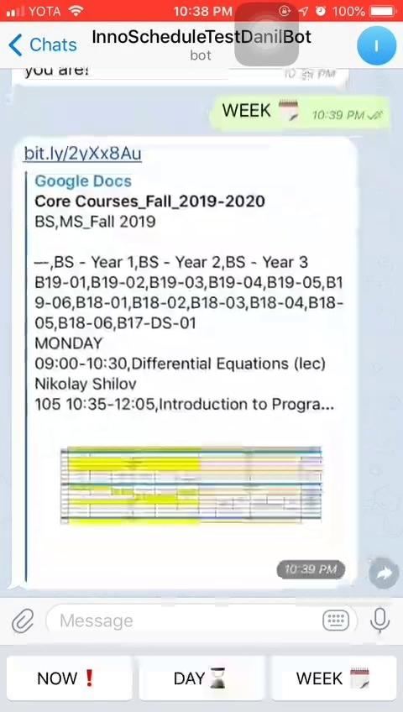
Demo of using telegram bot
Link>>

Slide 9
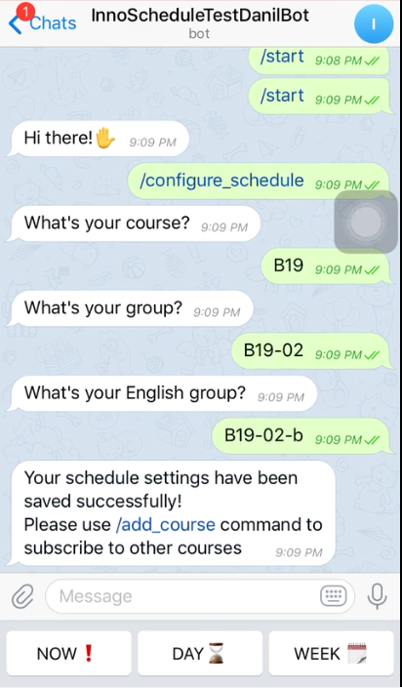
MVP and User Interface
The UI is easy to navigate and use;
Instructions and information simple and clear;
The MVP contained all the required functions of the InnoCalendar project;
All functionality of the MVP worked.

Slide 10
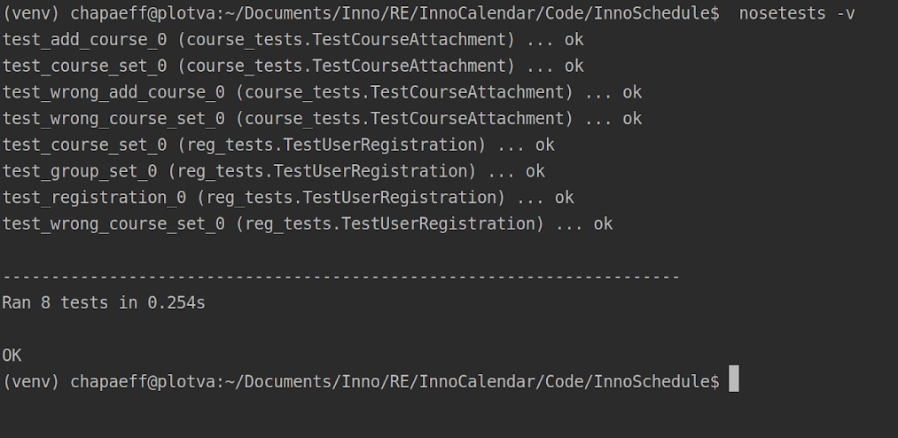
Demo of test runs of the telegram bot

Slide 11
Lessons learned
Our Project problems are man-made, therefore they may be solved by man;
Only constant is changes;
Nothing is obvious, when you create use ca
Test Case matrixes aren’t good, when we don’t have a lot of data inputs;
We need men team member who can dream of things that never were;
Leadership Teaching and learning are indispensable to each other;
Ask not what your country team can do for you - ask what you can do for your country team!
REMEMBER: Let’s make it all for one and all for love USER :)

Slide 12

Thank you
for Your attention

